Slide 1
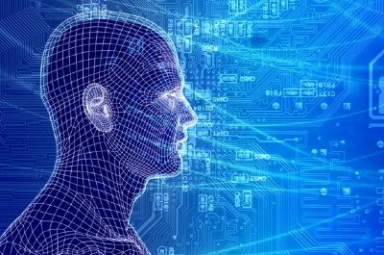
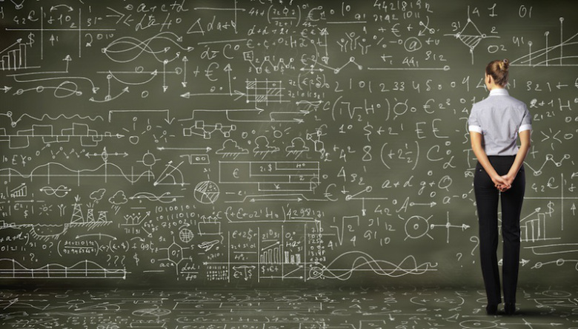
Recent Advances in Machine Learning And Their Application to Networking
David Meyer
dmm@{brocade.com,uoregon.edu,1-4-5.net,..}
http://www.1-4-5.net/~dmm/talks/2015/netnod_autumn_meeting.pptx
Netnod Autumn Meeting
14-15 October 2015
Stockholm, Sweden
https://www.netnod.se/netnod-autumn-meeting-2015

Slide 2
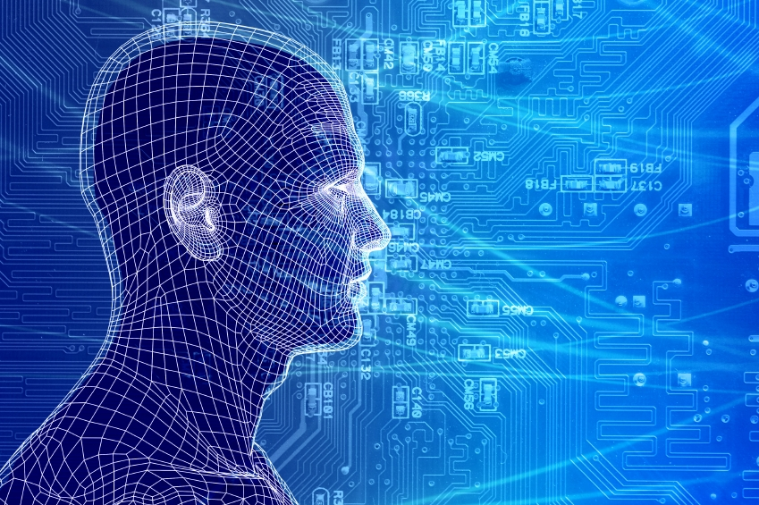
Goals for this Talk
To take a look at the current state
of the art in Machine Learning,
give us a basic understanding of
what Machine Learning is (to the
extent possible given our limited
time), and to understand how we
might use it in a network/automation
setting
While Machine Learning is really all about math, this talk attempts to go easy on all of that (just a little math…) ☺

Slide 3
Agenda
What is all the (ML) excitement about?
Very Briefly: What is ML and why do we care?
ML Tools for DevOPs
What the Future Holds
Q&A

Slide 4
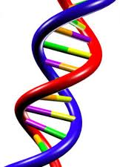
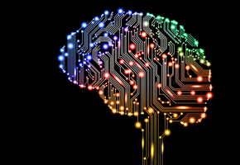

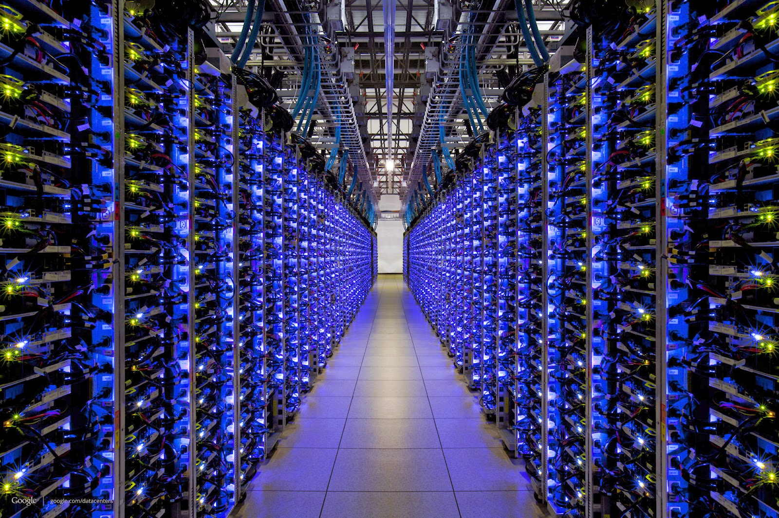
BTW, Before We Dive In… Where Does Knowledge Come From?
Evolution
Experience
Most of the knowledge in the world
of the future will be extracted by and
reside in machines -- Yann LeCun
Many orders of magnitude
faster and larger
Culture
Machines

Slide 5
So How Can Computers Discover New Knowledge?
Fill the gaps in existing knowledge
Symbolists
Induction/Inverse Deduction
Emulate the brain
Connectionists
Deep neural nets
Emulate evolution
Evolutionaries
Genetic Algorithms
Systematically reduce uncertainty
Bayesians
Bayesian Inference
- Notice similarities between old and new
Analogizers
Kernel machines/SVMs
These correspond to different schools of machine learning

Slide 6
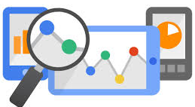
Ok, What is all the Excitement About? Context and Framing
Lots of excitement around “analytics” and machine learning
But what are “analytics”?

Slide 7
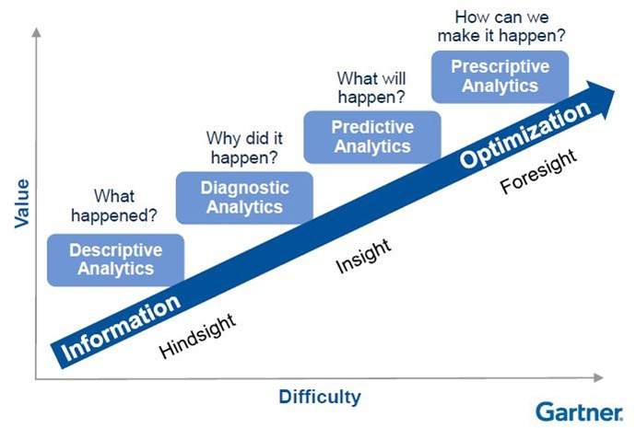
Conventional View of the Analytics Space
Focus here

Slide 8
Another Way To Think About This
The Automation Continuum
Management plane perspective
Machine Learning
Average Enterprise
Industry Pioneers
CONTROLLER-BASED ARCHITECTURE
CLI SCRIPTING
CLI
Manual
Automated/Dynamic
CLI
AUTOMATION
Machine
Intelligence
INTEGRATION
PROGRAMMABILITY
DEVOPS / NETOPS
ORCHESTRATION
Original slide courtesy Mike Bushong and Joshua Soto
Notes:
Most customers are at the very early side of this continuum of maturity when it comes to automating the network. They may have a couple of expect scripts, some MOPs and SOPs, but things are not really automated in any really meaningful way. They don’t have any sort of control framework or controller, not using OpenStack, not interested in programmability. Most want the network to be easier to manage.
Companies such as Netflix, are at the furthest end of the spectrum using a much more fully integrated Dev/NetOps approach
Our job is not to paint a picture of our customer’s full operational maturity, our job is to show them that we know what full operational maturity looks like and then get them further down the continuum in that direction.
Present in the industry today is a huge separation between where customers are today and the “vision” that everyone is talking about.
Your role as a sales person, is to be the TRUSTED ADVISOR that doesn’t judge the customer for where they are, but can identify their current pain point and point to a path to full operational maturity over the next several years.
Mike’s analogy for a 22hr treadmill session

Slide 9
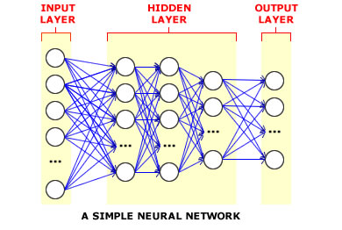
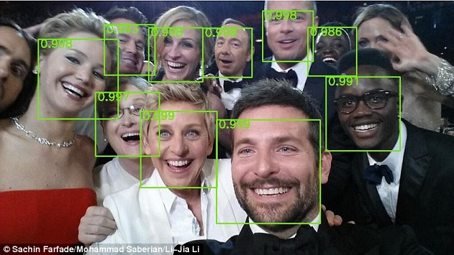
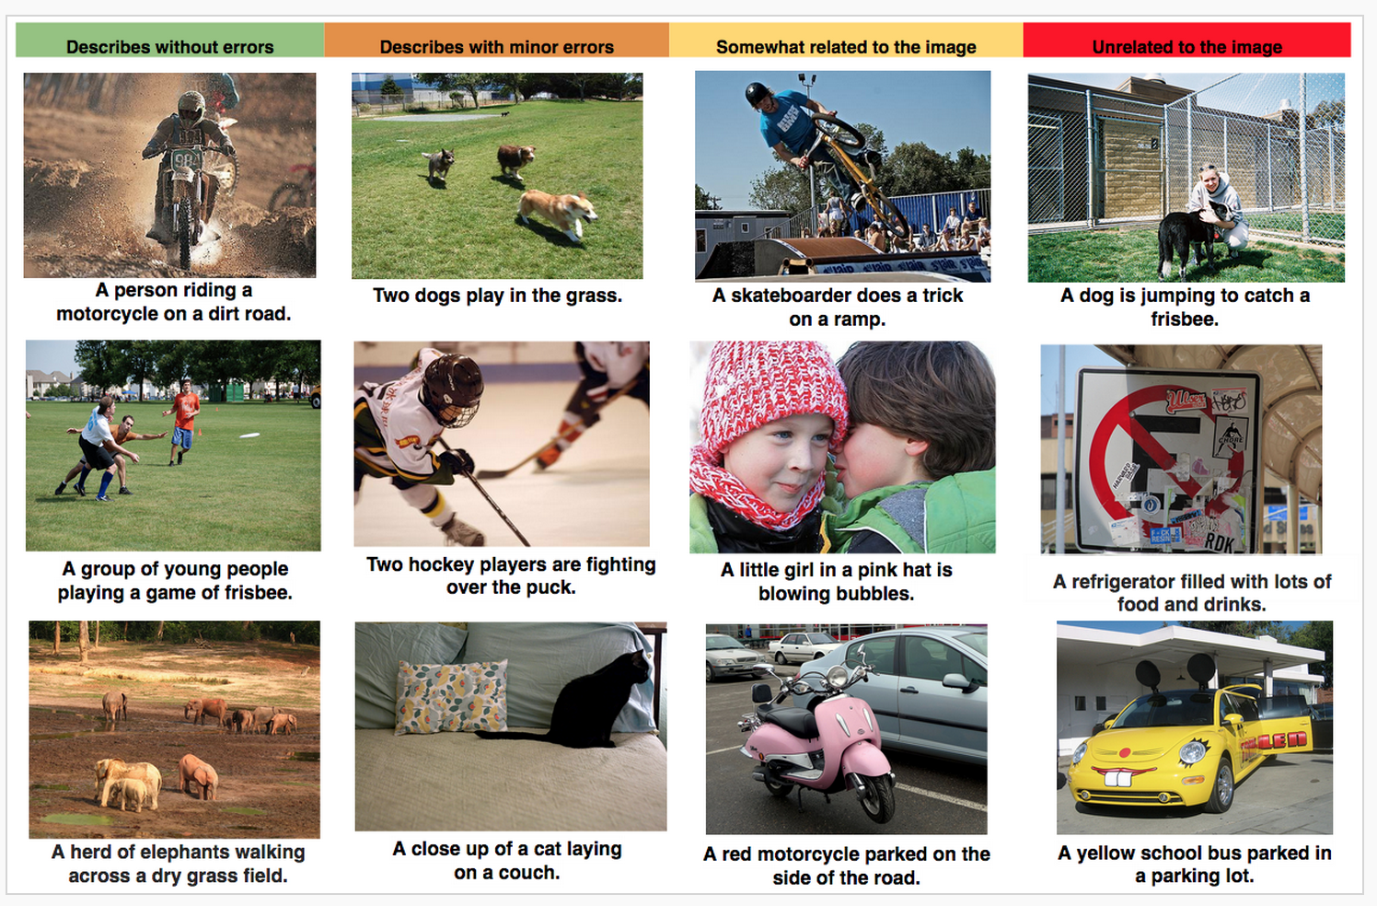
Ok, What is All the ML Excitement About?
Deep learning is enjoying great success in an ever expanding number of use cases
Multi-hidden layer neural networks
“Perceptual” tasks reaching super-human performance
Networking/non-cognitive domains still lagging
http://caia.swin.edu.au/urp/diffuse/papers.html (a bit older research)
Networking is a relatively new (but recently active) domain for ML
Auto-Captioning
Object Recognition
Why this is relevant: Network use cases will (eventually) use similar technologies

Slide 10
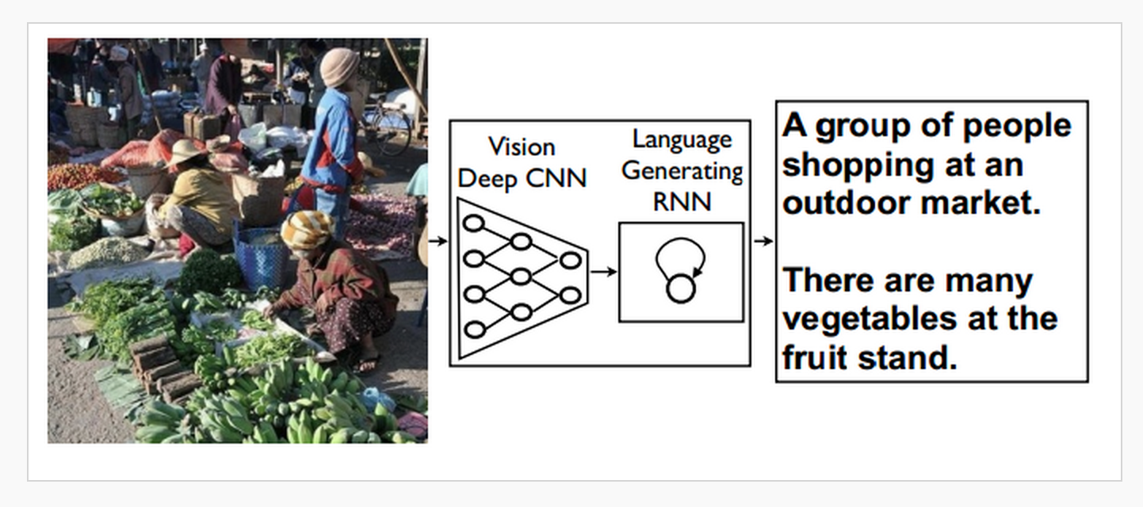
Auto-Captioning Cartoon How it Works

Slide 11
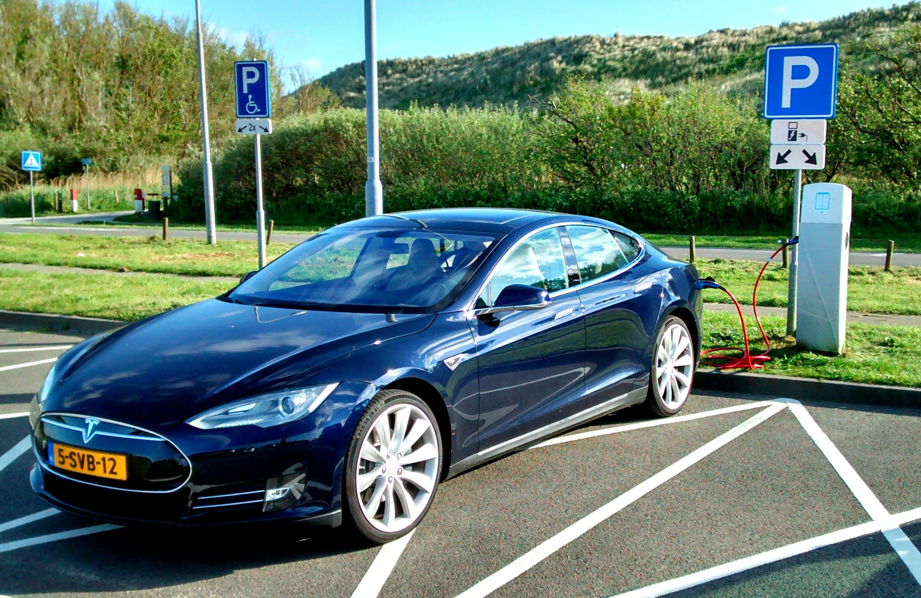
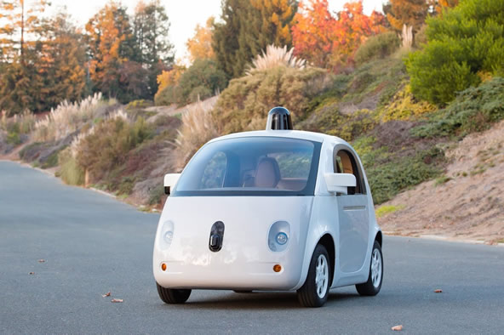

Self-Driving Cars
Notes:
Note massive 750Mb/

Slide 12
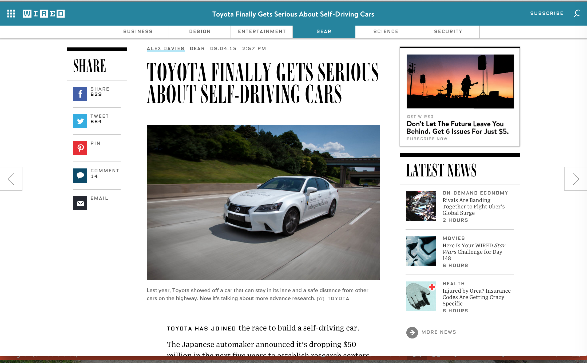
Toyota Industry trend: “Nuts and Bolts” to Intelligent Technology

Slide 13
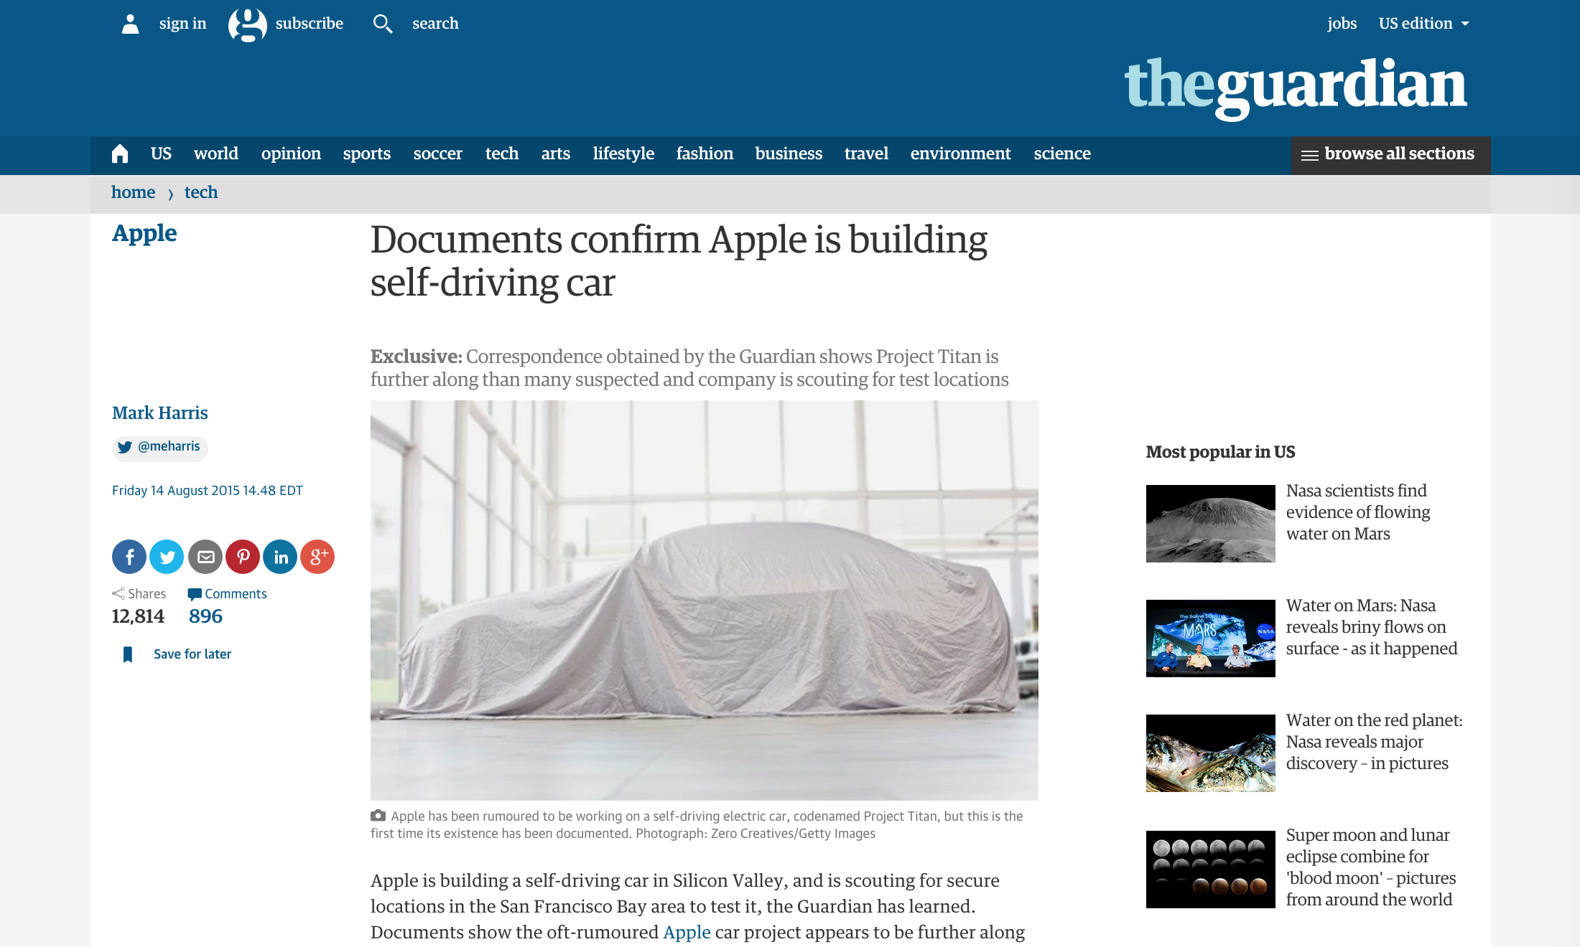
Apple

Slide 14
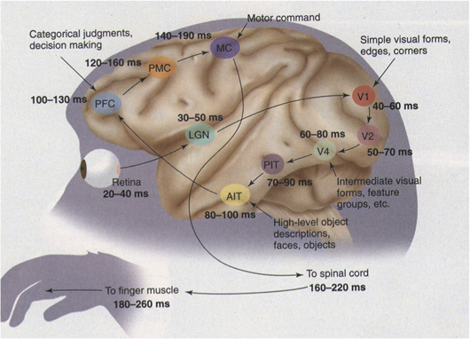
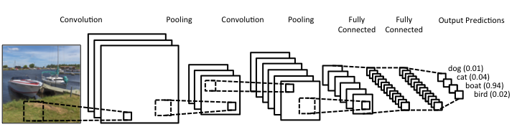
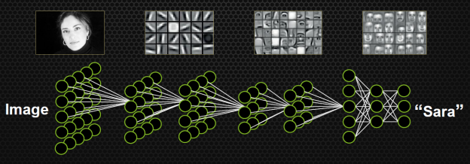
How Does Your Car Actually See?
How your car (camera, …) sees
Convolutional Neural Nets (CNNs)
How your brain sees
http://www.cns.nyu.edu/heegerlab/content/publications/Tolhurst-VisNeurosci1997a.pdf
Slide courtesy Simon Thorpe
See http://www.wired.com/2015/05/wolframs-image-rec-site-reflects-enormous-shift-ai/
Courtesy Simon Thorpe

Slide 15
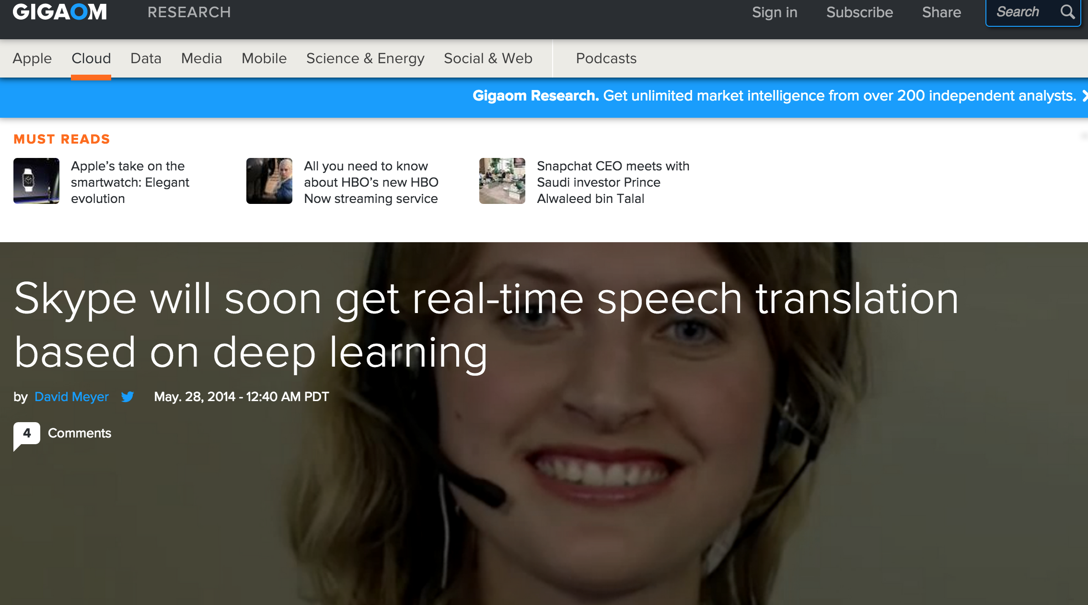
But There’s More

Slide 16
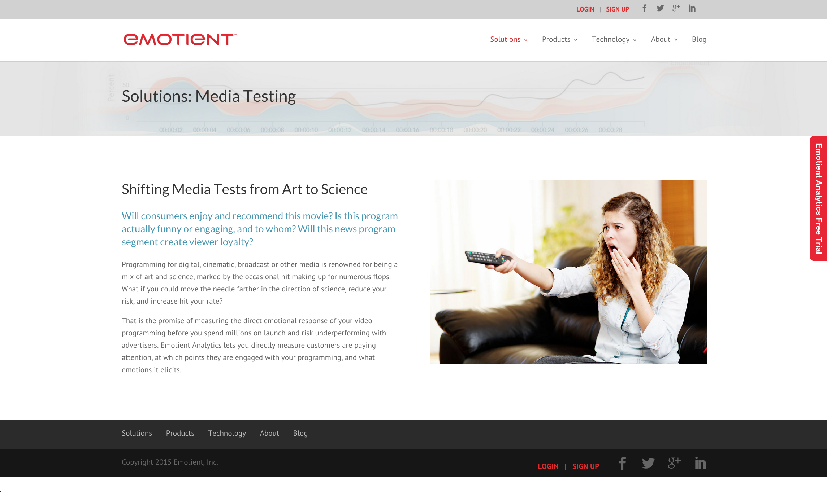
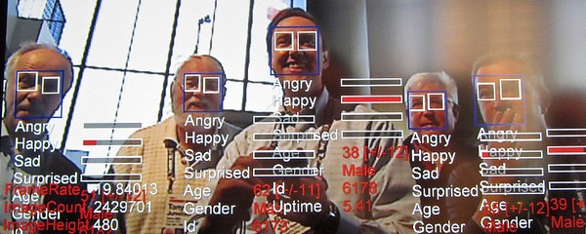
Think Speech/Object Recognition is Impressive?

Slide 17
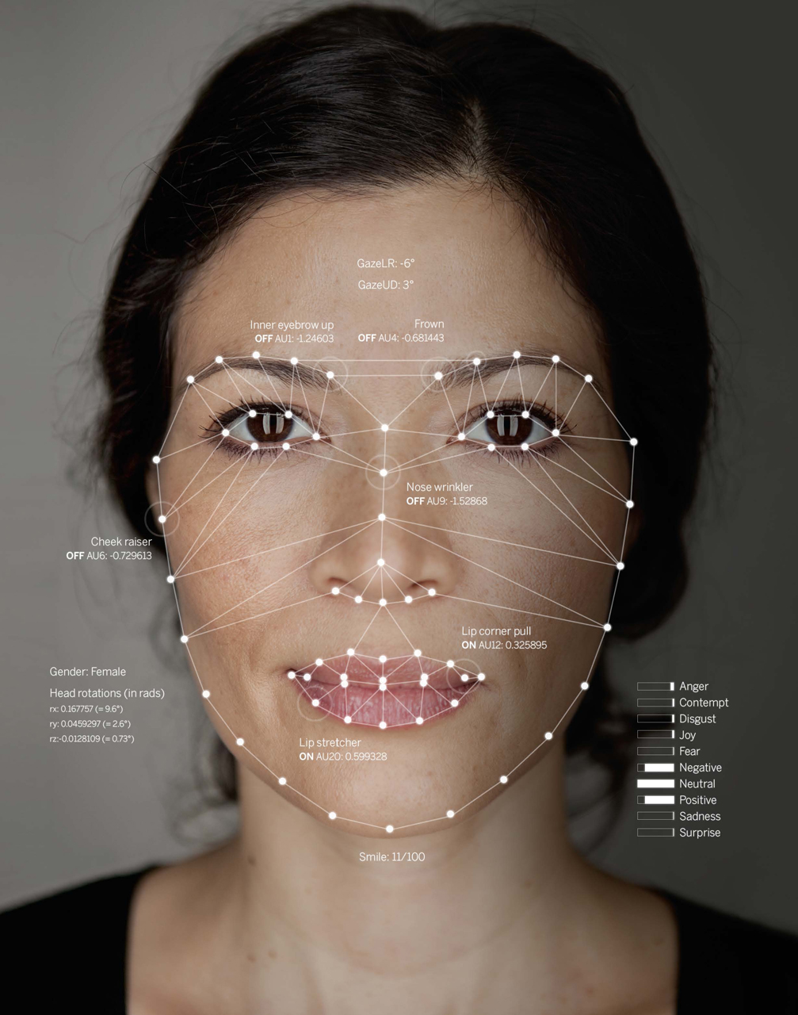

So How Does This Work?
Facial Keypoints
Jelena Stajic et al. Science 2015;349:248-249
Published by AAAS
Notes:
Illustration of how a virtual interviewer sees a human. The interviewer assesses the psychological state of the human by tracking and analyzing their facial expressions, body posture, and speech.

Slide 18
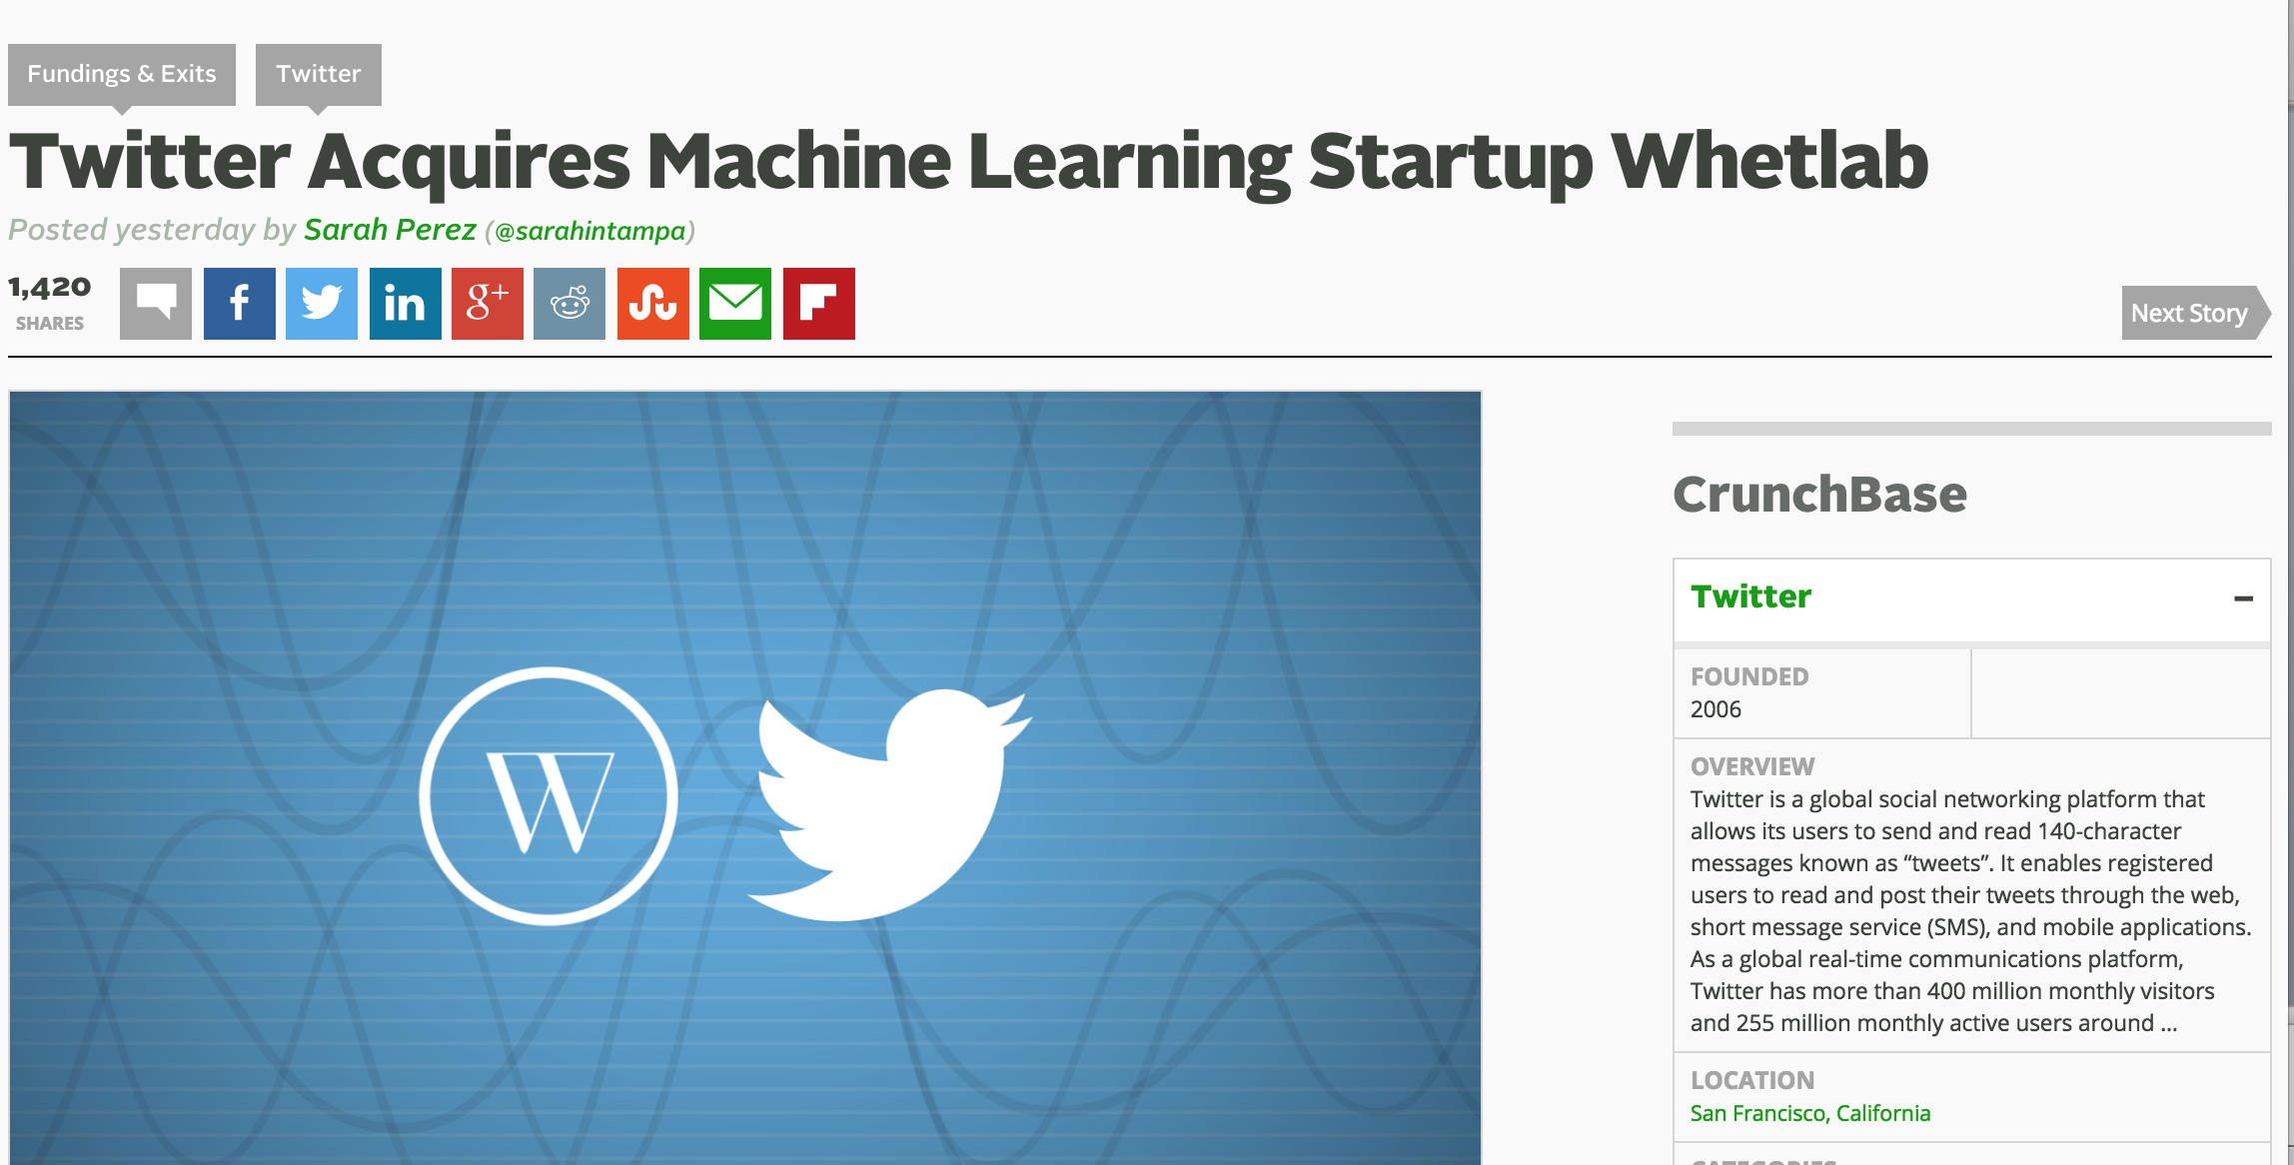
Everyone is getting into the game (M&A Gone Wild)
More Recently
http://www.cruxialcio.com/twitter-joins-ai-race-its-new-team-cortex-10393

Slide 19
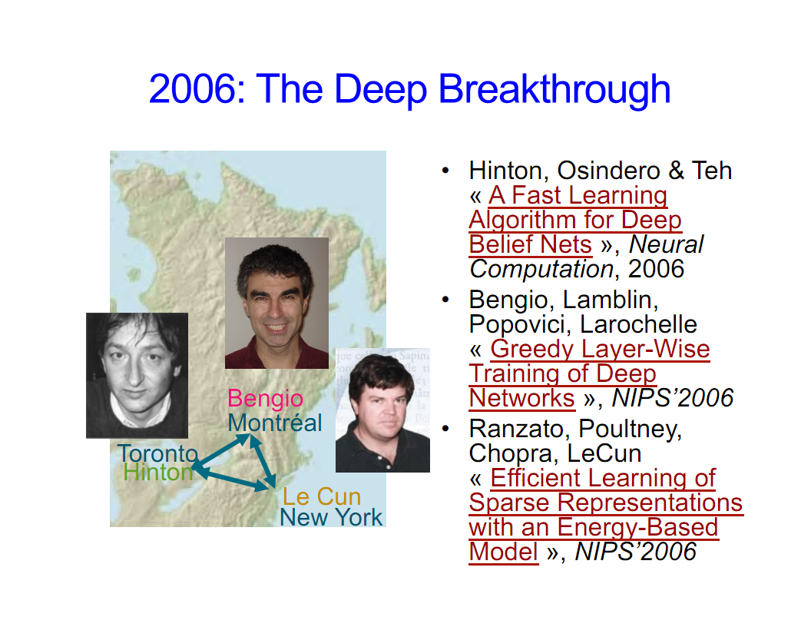
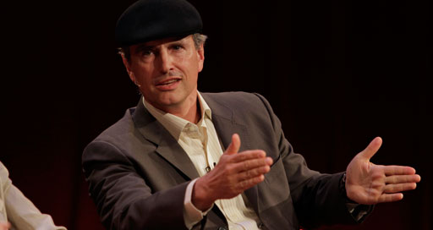
Why is this all happening now?
Before 2006 people thought deep neural networks couldn’t be trained
So why now?
Theoretical breakthroughs in 2006
Learned how to train deep neural networks
Technically: Solved the vanishing/exploding gradient problem(s) (“butterfly effects”)
More recently: http://www.cs.toronto.edu/~fritz/absps/momentum.pdf
Nice overview of LBH DL journey: http://chronicle.com/article/The-Believers/190147/
Compute
CPUs were 2^20s of times too slow
Parallel processing/algorithms
GPUs + OpenCL/CUDA
Datasets
Massive data sets: Google, FB, Baidu, …
And the convergence of theory/practice in ML
Alternate view of history?
LBH Nature DL review: http://www.nature.com/nature/journal/v521/n7553/full/nature14539.html
Jürgen Schmidhuber’s critique : http://people.idsia.ch/~juergen/deep-learning-conspiracy.html
LBH rebuttal: http://recode.net/2015/07/15/ai-conspiracy-the-scientists-behind-deep-learning/
Image courtesy Yoshua Bengio

Slide 20
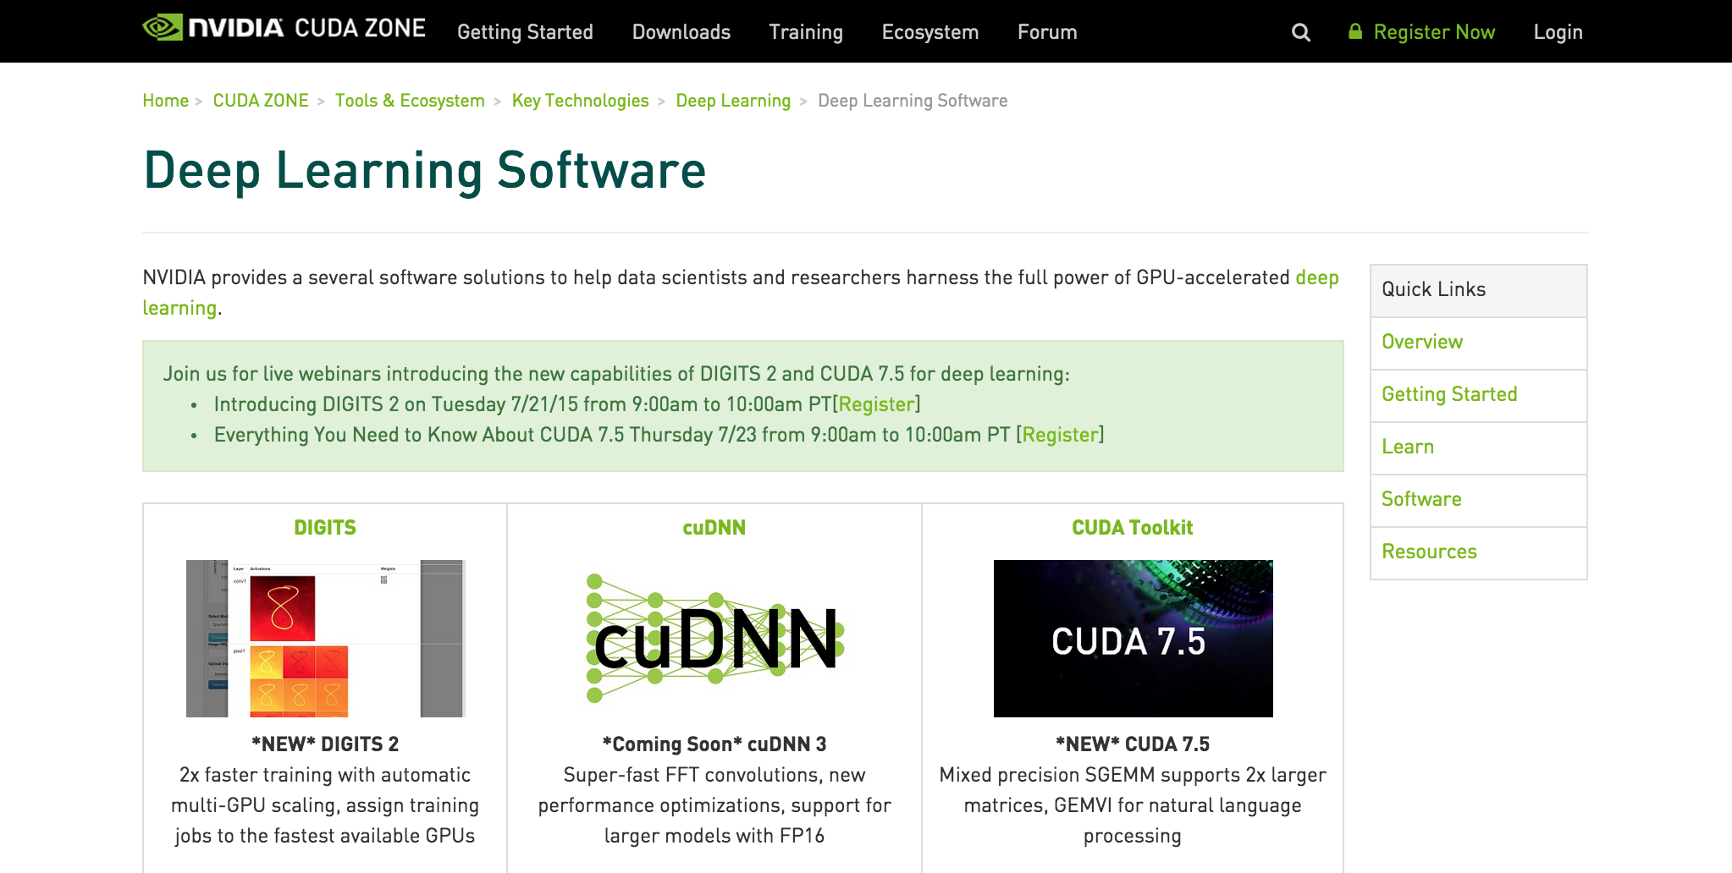
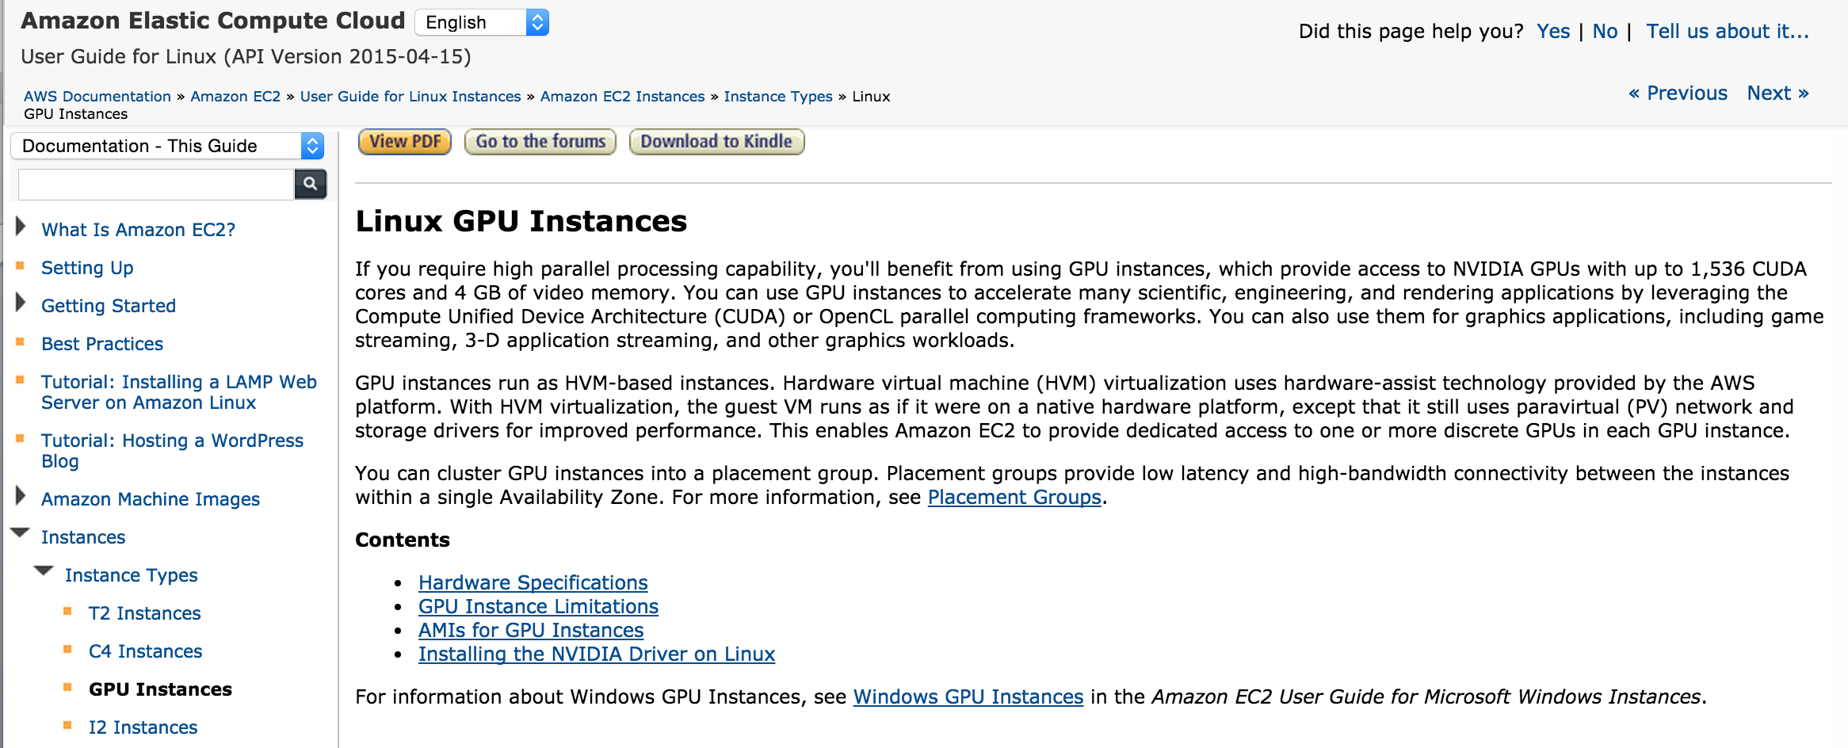
Aside: GPUs
CUDA/OpenCL support built into most open source ML frameworks
http://scikit-learn.org
http://torch.ch/
http://caffe.berkeleyvision.org/
http://apollo.deepmatter.io/
…
BTW, the ML community has a strong
and long standing open{source,data,model}
tradition/culture #openscience

Slide 21
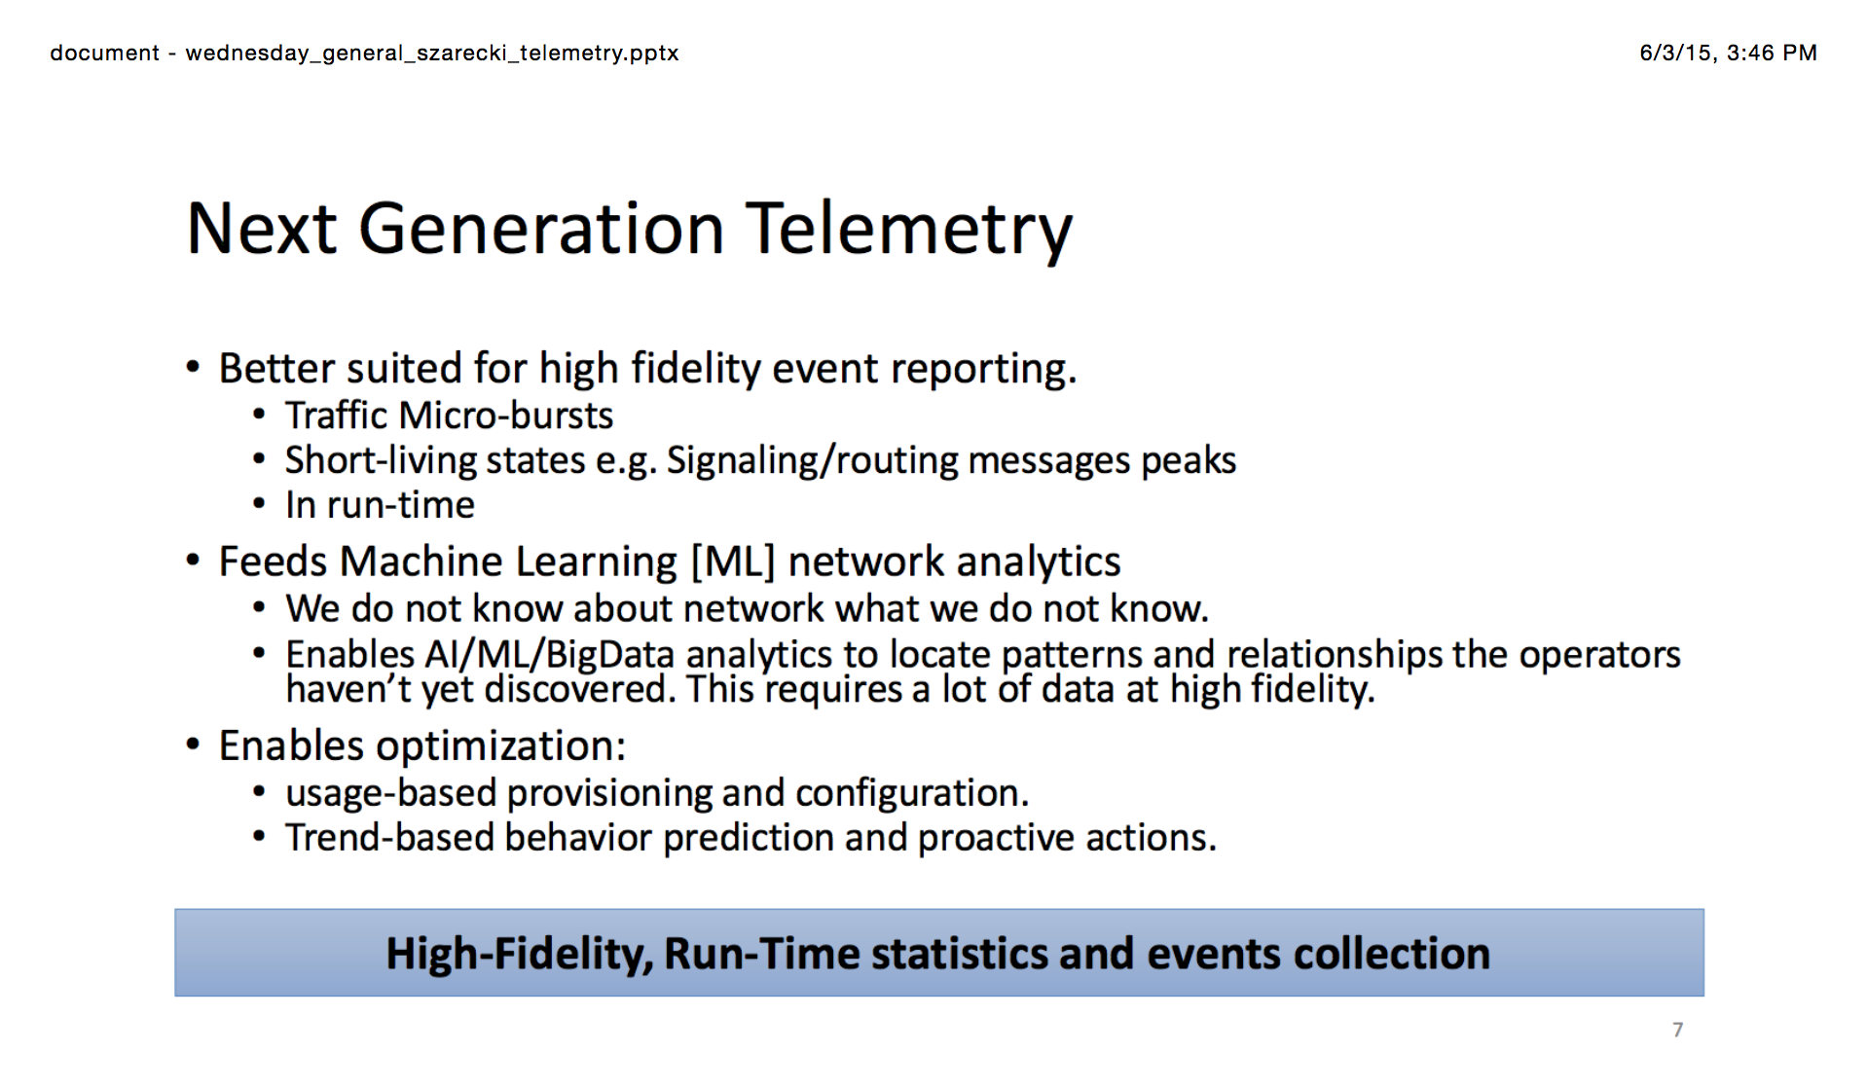
Ok, But What About Networking? (from NANOG 64)
See https://www.nanog.org/sites/default/files//meetings/NANOG64/1023/20150603_Szarecki_Architecture_For_Fine-Grain__v2.pdf

Slide 22
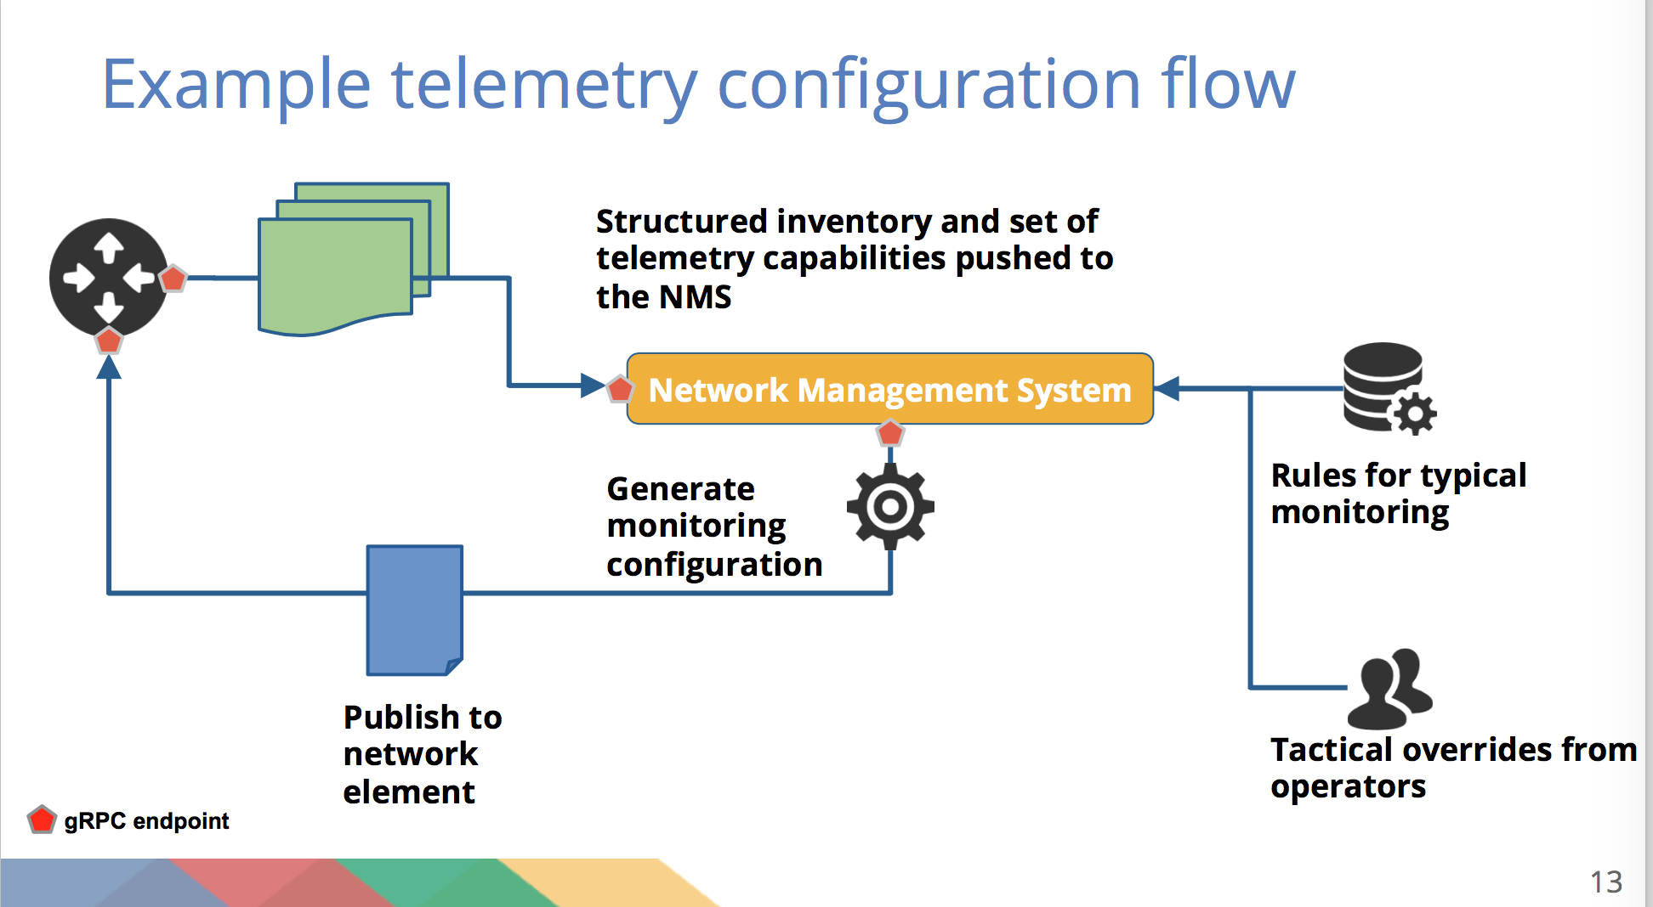
More from NANOG 64
See https://www.nanog.org/sites/default/files//meetings/NANOG64/1011/20150604_George_Sdn_In_The_v1.pdf

Slide 23
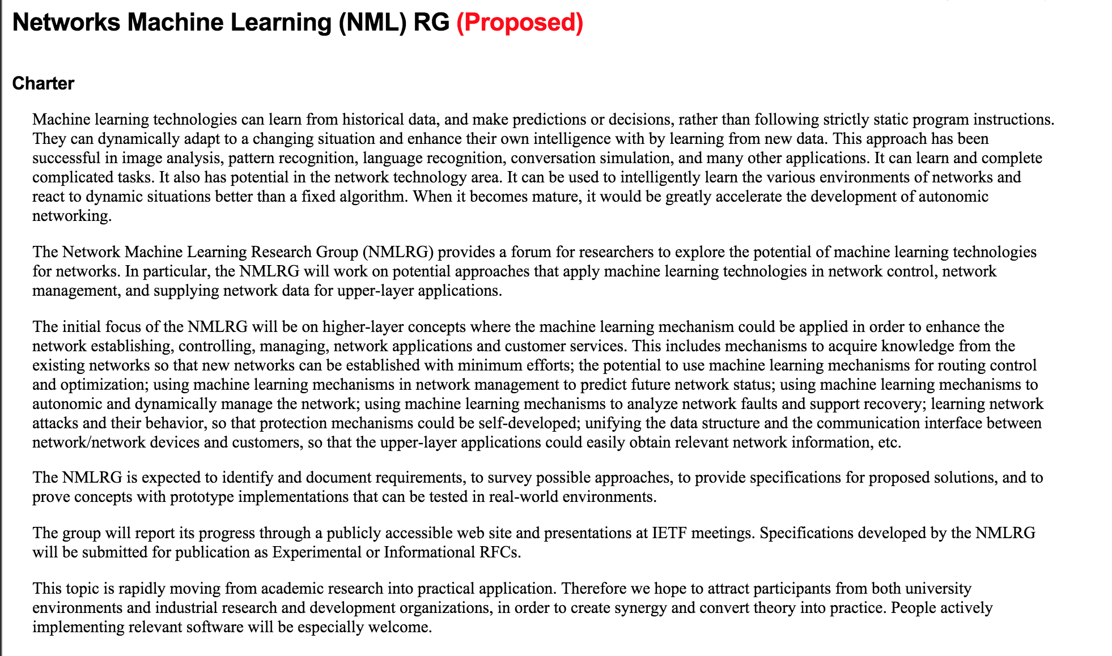
IRTF Current Events http://trac.tools.ietf.org/group/irtf/trac/wiki/nml

Slide 24
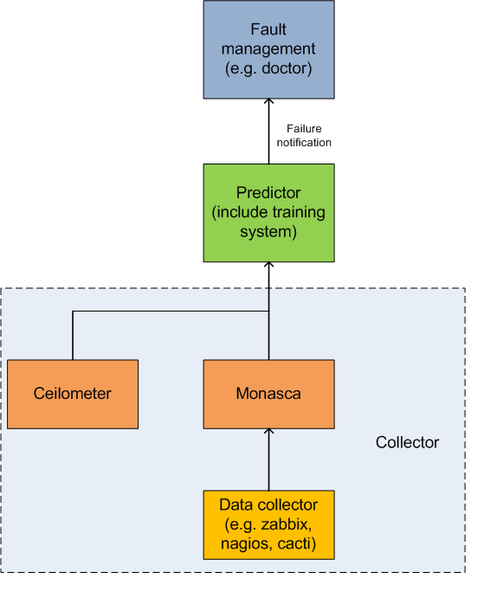
OPNFV
See https://wiki.opnfv.org/requirements_projects/data_collection_of_failure_prediction

Slide 25
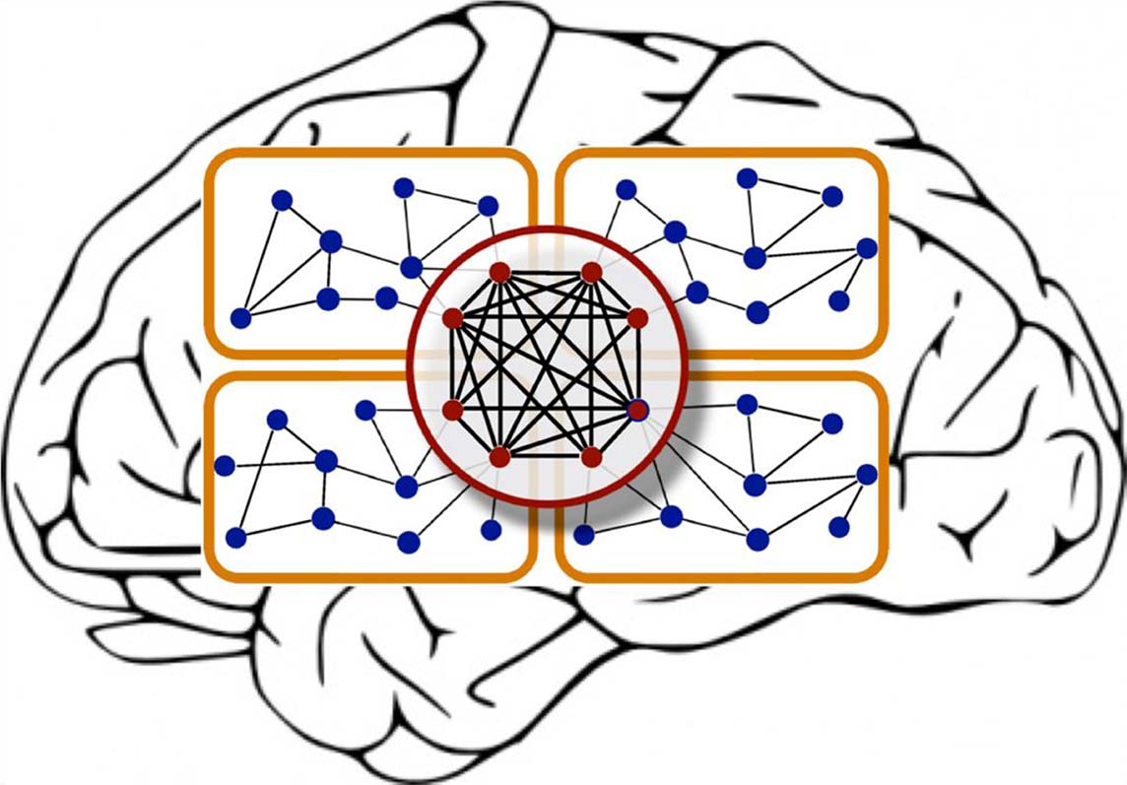
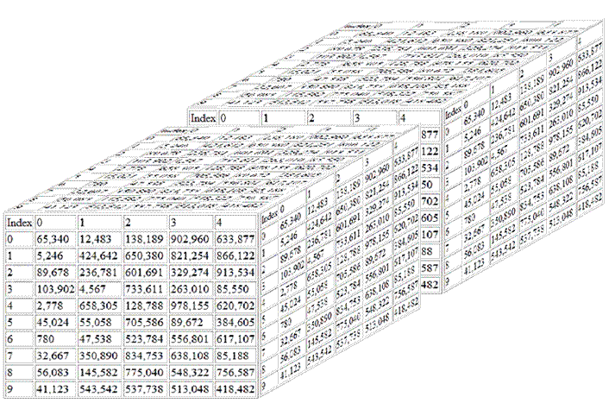
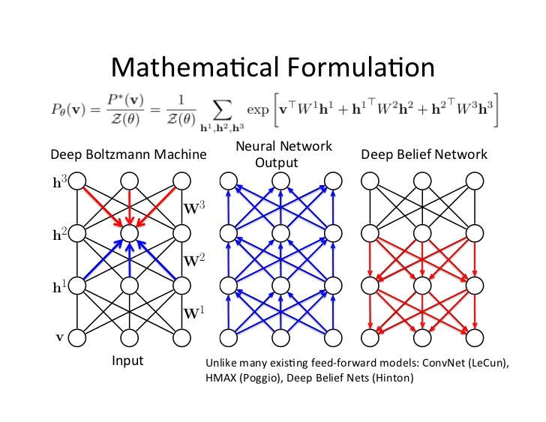
OK, Now Imagine This…
First, envision the network as a huge sensor network
Everything is a sensor (each counter, etc)
Each sensor is a dimension
This forms a high-dimensional real-valued vector space
Note: Curse of dimensionality (more later)
Well, guess what: With the right datasets
we can do this and much more
Guess what: This data is ideal for analysis/learning with deep neural networks
Contrast ML algorithms that use Local Estimation¹
Now imagine this kind of capability:
Interface ge 0/0/1 on gw-foo1 just flapped. This is going to cause
cpu utilization on gw-foo10 to spike and cause you to blackhole traffic to A.B.C.D/16 with probability .85. The probability distribution is visualized at http://….
And consider the
implications for the
security space
1 http://www.iro.umontreal.ca/~lisa/pointeurs/TR1312.pdf

Slide 26
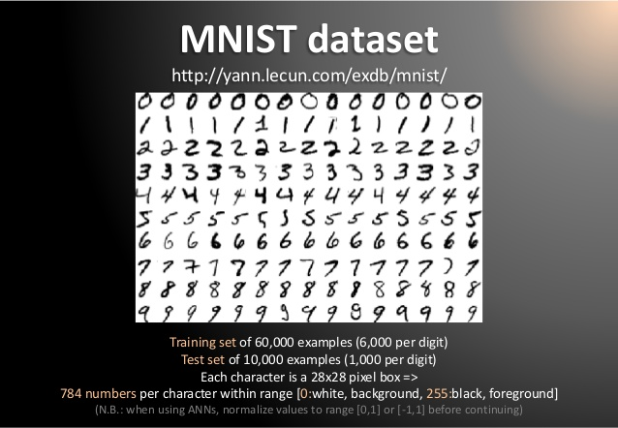
Aside: Dimensionality
Machine Learning is good at understanding the structure of high dimensional spaces
Humans aren’t ☹
What is a dimension?
Informally…
A direction in the input vector
“Feature”
Example: MNIST dataset
Mixed NIST dataset
Large database of handwritten digits, 0-9
28x28 images
784 dimensional input data (in pixel space)
Consider 4K TV → 4096x2160 = 8,847,360 dimensional pixel space
But why care?
Because interesting and unseen relationships
frequently live in high-dimensional spaces

Slide 27
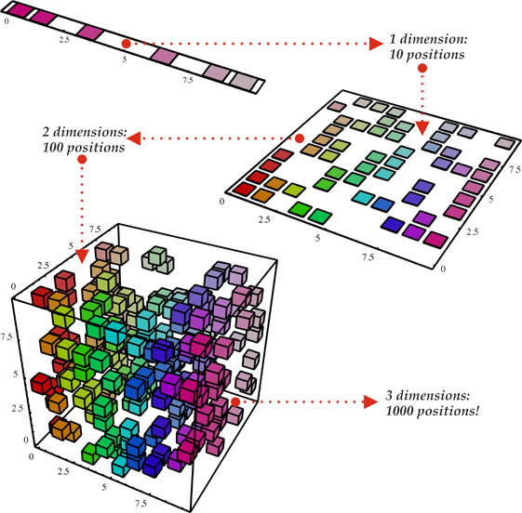
But There’s a Hitch The Curse Of Dimensionality
To generalize locally, you need representative examples from all relevant variations
But there are an exponential number of variations
So local representations might not (don’t) scale
Classical Solution: Hope for a smooth enough target function, or make it smooth by handcrafting good features or kernels. But this is sub-optimal. Alternatives?
Mechanical Turk (get more examples)
Deep learning
Distributed Representations
Unsupervised Learning
…
(i). Space grows exponentially
(ii). Space is stretched, points
become equidistant
See also “Error, Dimensionality, and Predictability”, Taleb, N. & Flaneur, https://dl.dropboxusercontent.com/u/50282823/Propagation.pdf for a different perspective

Slide 28
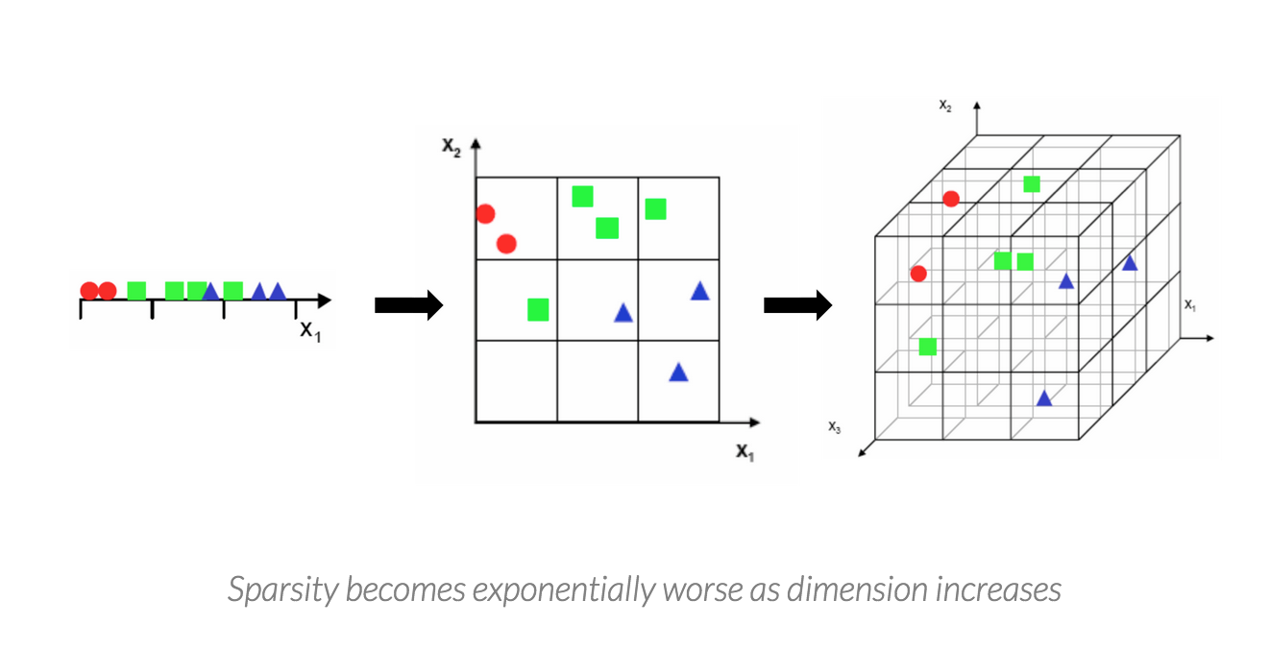
Seen Another Way

Slide 29
Agenda
What is all the (ML) excitement about?
Review: What is ML (and why do we care)?
ML Tools for DevOPs
What the Future Holds
Q&A

Slide 30
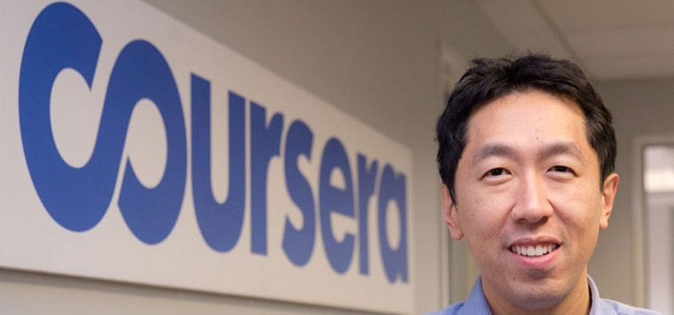
All Cool, But What is Machine Learning?
The complexity in traditional computer programming is in the code (programs that people write). In machine learning, learning algorithms are in principle simple and the complexity (structure) is in the data. Is there a way that we can automatically learn that structure? That is what is at the heart of machine learning.
-- Andrew Ng
Said another way, we want to discover the Data Generating Distribution (DGD) that underlies the data we observe. This is the function that we want to learn.
Moreover, we care about primarily about the generalization accuracy of our model (function)
Accuracy on examples we have not yet seen
as opposed the accuracy on the training set (note: overfitting)

Slide 31
The Same Thing Said in Cartoon Form
Traditional Programming
Machine Learning
Data
Computer
Output
Program
In short, learning in a Machine Learning setting
outputs a program (read: code) that runs on a
specialized “abstract machine”
Data
Computer
Program
Output

Slide 32
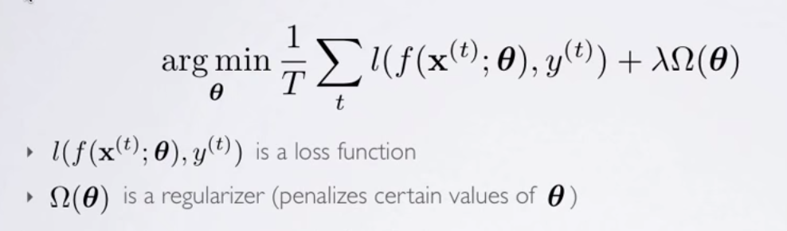
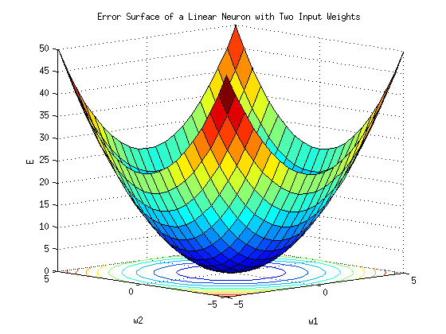
A Little More Detail
Machine Learning is a procedure that consists of estimating model parameters so that the learned model can perform a specific task (sometimes called Narrow or Weak AI; contrast AGI)
Approach: Estimate model parameters (usually denoted θ) such that prediction error is minimized
Empirical Risk Minimization casts learning as an optimization problem
3 Main Classes of Machine Learning Algorithms
Supervised
Unsupervised
Reinforcement learning
Semi-supervised learning
Supervised learning
Here we show the learning algorithm a set of examples (x_{i}) and their corresponding outputs (y_{i})
You are given a training set {(x_{i},y_{i})} where y_{i} = f(x_{i}). We want to learn f
Essentially have a “teacher” that tells you what each training example is
See how closely the actual outputs match the desired ones
Note generalization error (bias, variance) vs. accuracy on the training set
Most of the big breakthroughs have come in supervised deep learning
Unsupervised Learning
Algorithm learns internal representations and important features
Unlabeled data sets
Reinforcement Learning
Learning agent maximizes future reward
Dynamic system with feedback control
Robots
Images courtesy Hugo Larochelle and Andrew Ng

Slide 33
Aside: Feed Forward Neural Networks
Artificial Neurons
The information is propagated from the inputs to the outputs
Directed Acyclic Graph (DAG)
Computes one or more non-linear functions
Computation is carried out by composition of some number of algebraic functions implemented by the connections, weights and biases of the hidden and output layers
Hidden layers compute intermediate representations
Dimension reduction
Time has no role -- no cycles between outputs and inputs
However, in some models each hidden layer models one time step
Maps vectors to vectors
Output layer
2nd hidden
layer
1st hidden
layer
x₁
x₂
…..
x_{n}
We say that the input data, or features, are n dimensional

Slide 34
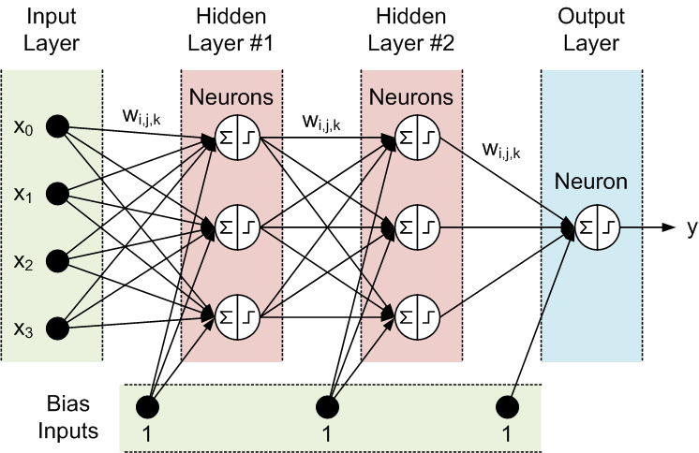
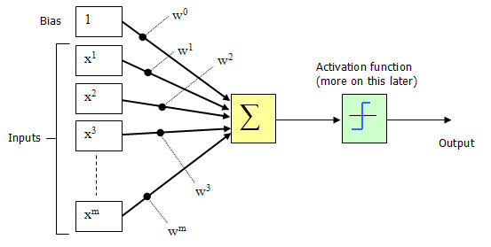
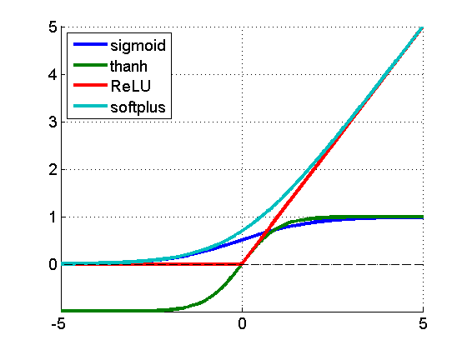
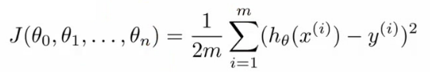
Deep Feed Forward Neural Nets (most of the math I’m going to give you is on this slide ☺)
(x^{(i)},y^{(i)})
h_{θ}(x^{(i)})
Where do the weights come from?
Hypothesis
f(x^{(i)})
Forward Propagation
So what then is learning?
Learning is the adjusting of the weights w_{i,j} such that
the cost function J(θ) is minimized
Simple learning procedure: Back Propagation (of the error signal)

Slide 35
Agenda
What is all the (ML) excitement about?
Review: What is ML (and why do we care)?
ML Tools for DevOPs
What the Future Holds
Q&A

Slide 36
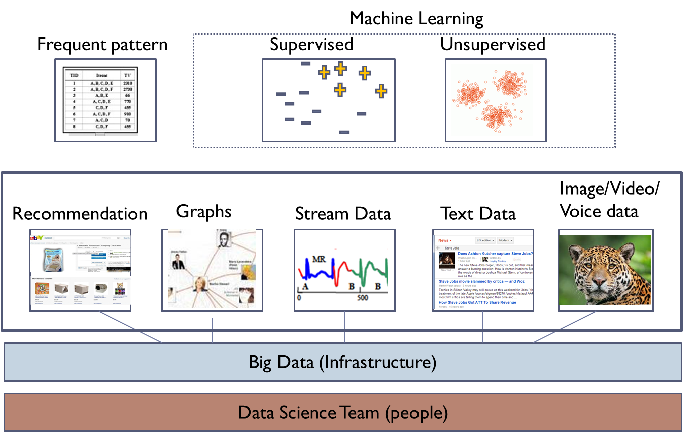
Prototypical ML Stack

Slide 37



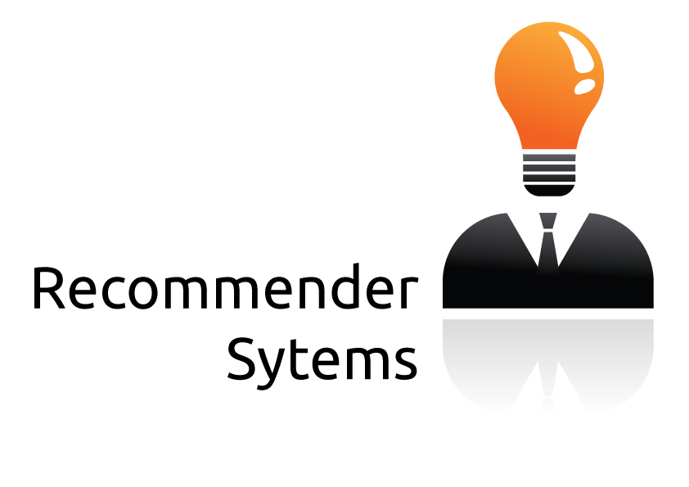



Workflow Schematic
Domain Knowledge
Domain Knowledge
Domain Knowledge
Domain Knowledge
3rd Party Applications
Analytics Platform
Learning
Presentation Layer
Intelligence
Data Collection
Packet brokers, flow data, …
Preprocessing
Big Data, Hadoop, Data Science, …
Model Generation
Machine Learning
Oracle
Model(s)
Remediation/Optimization/…
Oracle
Logic
Intent
Topology, Anomaly Detection,
Root Cause Analysis,
Predictive Insight, ….

Slide 38
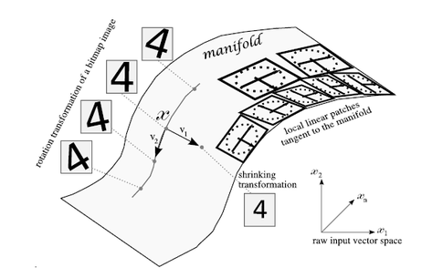
Simple Example: Application Profiling
Goal: Build tools for the DevOps environment
Provide deeper automation and new capabilities/insight
Obvious ML application
Primarily management plane
One approach: Frequent Pattern Mining and K-Means to learn/predict application behavior
FP Mining really more of a simple statistical method
K-Means is an unsupervised local estimator →
Partitions the input space into regions
Each region requires different parameters/degrees of freedom
Regions are needed to account for the shape of the target function
Image courtesy Yoshua Bengio

Slide 39
Applying Occam’s Razor
One of the first applications for DevOps we’ve done is Application Profiling
Continues to the right on the Automation Continuum
Use Frequent Pattern (FP) Mining and K-Means to gain a deeper understanding of what’s happening in our CSNSE
CSNSE = Compute, Storage, Network, Security, and Energy
Why is this an application of Occam’s Razor?
What do we mean by “Application Profiling”?
First, let’s briefly look at the FP Mining and K-Means algorithms

Slide 40
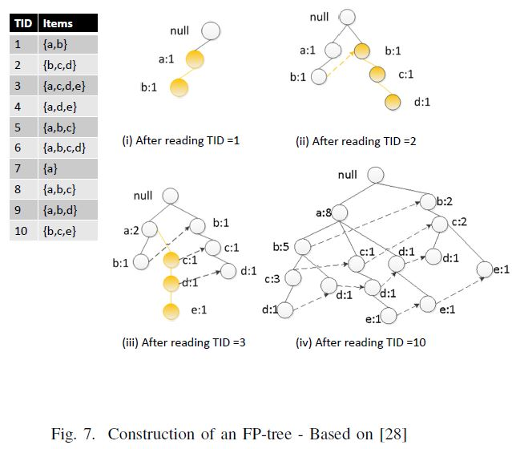
Frequent Pattern Mining (FP Growth Algorithm)
FP builds a inclusion graph
reports frequent patterns (itemsets)
works on “categorical” data
data with no meaningful ordering

Slide 41


K-Means (K-Means Clustering)
PCA

Slide 42



A Little More on K-Means K-Means Algorithm
Can show that this algorithm minimizes this distortion function
In words
Randomly initialize cluster centroids (the μ_{i}’s)
Until convergence
Assign each observation to the closest cluster centroid
Update each centroid to the mean of the points assigned to it

Slide 43
Putting It All Together
FP Mining finds patterns in categorical data
Returns “itemsets”
Sets of Transaction IDs (TIDs) corresponding to some pattern
[src,dest,srcprt,destprt,oif,appname,…]
K-Means finds clusters in continuous data
A cluster can be things like
The set of TIDs that show congestion, …
Putting these algorithms together allows us to make the following (very) simple inference:
TIDset_{FP} ∧TIDset_{K-Means} → patterns that cluster together
“These application patterns occur with congestion”
TID sets
(clusters)

Slide 44
BTW, how hard is it to code up FP in Spark/MLlib/Scala (or Python, Java, R)?
// ... ETL the dataset(s)
val transactions = rawData.map {line =>
val buffer = ArrayBuffer[String]()
buffer.appendAll(line.split(",")) // kddcup99 csv and terminology
Array(buffer(Proto), // buffer(1) protocol_type: symbolic
buffer(Service), // buffer(2) service: symbolic
buffer(Flag), // buffer(3) flag: symbolic
buffer(buffer.length-1)) // buffer(length-1) label
}.cache()
val fpg = new FPGrowth()
.setMinSupport(MinSupport) // model hyper-parameters
.setNumPartitions(Partitions) // hyper-parameters
val model = fpg.run(transactions)
model.freqItemsets.collect().foreach {itemset =>
println(itemset.items.mkString("[", ",", "]") + ", " + itemset.freq)
}
Spark: https://spark.apache.org/downloads.html
Code: https://github.com/davidmeyer/ml
Dataset: http://kdd.ics.uci.edu/databases/kddcup99/kddcup99

Slide 45
What About K-Means?
// ... ETL the dataset(s) → normalizedData
val kmeans = new KMeans()
.setK(K)
.setRuns(Runs)
.setEpsilon(Epsilon)
val model = kmeans.run(normalizedData)
val clusterAndLabel = rdataAndLabel.map {
case (normalizedData,label) => (model.predict(normalizedData), label)}
val clusterLabelCount = clusterAndLabel.countByValue
clusterLabelCount.toList.sorted.foreach {
case ((cluster,label), count) => println(f"$cluster%1s$label%18s$count%8s")}
Code: https://github.com/davidmeyer/ml

Slide 46

Application Profiling, cont
First, we need data (obvious, but ingestion, … not trivial)
Lots of engines (spark, storm, tigon/cask.io,…)
Data we have collected (among other things)
Network and endpoint information
Environmental sensor data
Chef/Puppet, Openstack Heat, server/cluster state,…
…
The FP-KMeans pipeline can be used build application profiles
Which endpoints an application talks to (and associated templates)
Which ports and protocols it uses
and associated meta-data, geo-ip, …
Flow characteristics including as TOD, volume and duration
Other CSNSE configuration associated with the application
ACL/QoS, routing policies,…
…
We are really limited only by our imagination and (of course) our datasets
Primarily descriptive/diagnostic analyzes

Slide 47
So what is more interesting…
We can use the same FP-KMeans pipeline in a predictive way
For example, we can analyze changes to predict possible behavior
This ACL/Routing/QoS change will cause event <X> with probability P
If you configure app <X> with params <Y> there is prob P of congestion
…
We can correlate real-time application profiles with events/state
Application <X> is green (intelligent dashboard)
Queue <X> is dropping <Y>% of it's packets; app <Z> is talking to this endpoint
…
We wan also use application profiles to train other ML instances
Recognize application behavior in real time
Detect anomalies
Points that are far from any cluster (K-Means), and/or
p(X; μ, 𝚺) < ε (say in a multivariate Gaussian 𝓝(μ,𝚺) anomaly detection setting)
Security use cases
…
…
This can all be made “streaming”/real-time

Slide 48



BTW, What (technically) are Anomalies?
An anomaly is a pattern that does not conform to the expected behaviour
How to define expected behaviour?
How to find the “outliers”?
Anomalies translate to significant real life events
Cyber intrusions
Cyber crime
Manufacturing/product defects
…
Linear Decision Boundary
Graphic courtesy Andrew Ng, others

Slide 49


BTW, What is Really Happening Here?
Linear Decision Boundary
Target function represented by input data is some twisted up manifold
Deep nets disentangle the underlying explanatory factors in the data so as to make them linearly separable
Graphic courtesy Christopher Olah
Voronoi diagram under Euclidian distance
Voronoi diagram under Euclidian distance
Linear Separability in a Neural Network
Linear Separability in a Neural Network

Slide 50
Basic Idea Behind Anomaly Detection
An anomaly
Idea: Assume that a boundary exists and that - Nominal data is inside the boundary - Anomalous data is outside the boundary
Problem: How to estimate/approximate the boundary?
Problem: What measurement(s) caused the anomaly?
Collected ‘Nominal’ Data
Problem: How far off-nominal is the anomaly/feature?

Slide 51

One Way To Visualize Anomalous Behavior Generalization Graph Radial Nested Block State Model with Edge Bundling

Slide 52
Agenda
What is all the (ML) excitement about?
Review: What is ML (and why do we care)?
ML Tools for DevOPs
What the Future Holds
Q&A

Slide 53


What The Future Holds
These technologies, which have been so successful in perceptual tasks, are coming to networking…now
Extremely powerful deep neural nets (DNNs)
Remember, conventional statistical models learn simple patterns or clusters
OTOH, large DNNs learn a computation (function)
More emphasis on control
e.g., RNN/Memory Nets, Reinforcement learning
Can analyze sophisticated time-series/long range dependencies
ML will be doing unexpected network (CSNSE) tasks
Who thought we’d be this close to self-driving cars?
DNNs already write code
The weight matrix W (this is what is learned)
DNNs solve the selectivity-invariance dilemma
We will see progressively more ML in networking
Predictive and reactive roles in management, control and data planes
This will change the nature of how we design, build and operate networks
Recently proposed: IRTF RG on ML for Networking
http://trac.tools.ietf.org/group/irtf/trac/wiki/nml
We are at the very beginning of a “network intelligence” revolution
weights w_{i,j}

Slide 54

Q&A
Thanks!
http://www.1-4-5.net/~dmm/talks/2015/hoti.pptx

